Slide 1
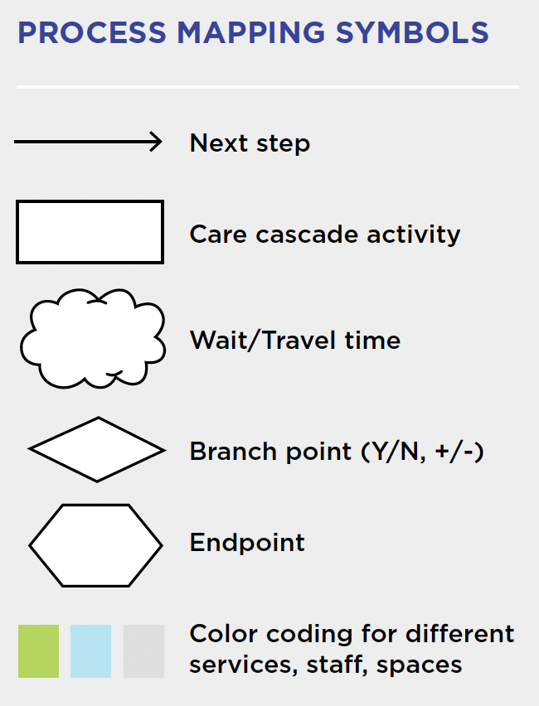
Process Map of Clinic Work Flow
Contraceptive visit initiation
Pt enters clinic
Front desk staff confirms reason for the visit
Patient completes paperwork, insurance status confirmed
SINC Screener
Does the pt have insurance?
Wait room
Y
N
Triage, SINC screener by MA, EHR note
Referred to benefits coordinator
N
EHR note reason, usual care
Y
EHR note, inform provider
Exam room
Rx BC selected
6 mo. follow up
PCCC
Y
Nurse education
Other education
6 mo. follow up
N

Slide 2
Process Map of Clinic Work Flow
Y
N
N
Y
Y
N

